Slide 1
Ads Classification
By Yatin Vij

Slide 2
Problem Statement
“ Classify the comment on the blog post as an Advertisement or not an Advertisement based on the given data associated with the comment. ”

Slide 3
Section - A
Approach

Slide 4
Data Science Pipeline
Load the data
Data Quality Check
Feature Generation
Explore the data
Feature Selection
Text Processing
Feature Extraction
Modelling
Model Evaluation using Cross-Validation
Model Selection

Slide 5
Dataset
The dataset given contains comma separated entries for each attribute.
The attributes of the data are:
COMMENT_ID
AUTHOR
DATE
CONTENT
CLASS
The train data contains a total of 1157 observations and the test data contains 232 observations.

Slide 6
Data Quality Check
Missing Values found for DATE attribute in the train set.
Redundant Comment found in the train data and was dropped from the data.

Slide 7
Feature Generation
Features Generated to find patterns between the CONTENT of the comment and the CLASS.
Word Count was generated from the CONTENT attribute to find the word count of each comment.
Comment Length was generated from the CONTENT attribute to calculate the length of the comment string.

Slide 8
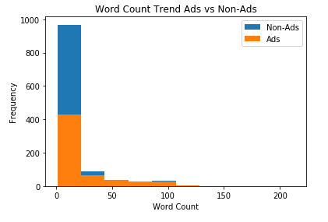
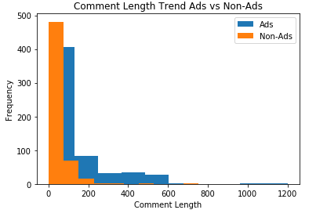
Exploratory Data Analysis
Ad trend w.r.t. Word Count and Comment Length
This shows the generated attributes do not add any information or follow a pattern that can help in modelling ad comments.

Slide 9
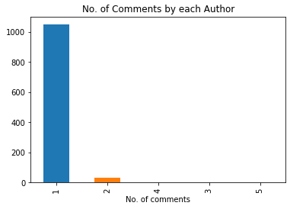
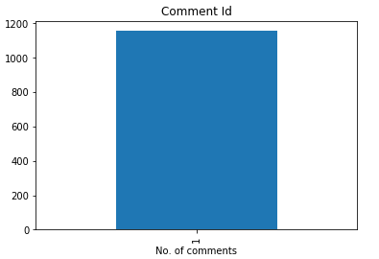
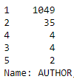
Exploratory Data Analysis
Checking the distributions of AUTHOR and COMMENT_ID
This shows that mostly the people comment only once and all the comment id are unique so they add no information.

Slide 10


Exploratory Data Analysis
Generated Word clouds for Ads and Non-Ads.
The word clouds show the most occurring words in ad and non-ad comments.

Slide 11
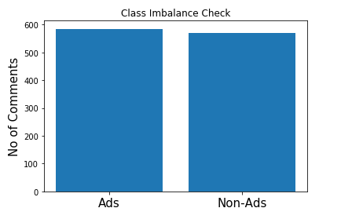
Exploratory Data Analysis
Performing Class Imbalance Check
We see that the Ads and Non-Ads have almost same frequency.

Slide 12
Feature Selection
EDA shows that the only attribute that adds valuable information that can be used by the model is CONTENT.
Thus, we remove all the attributes except CONTENT and CLASS from the data and proceed with text preprocessing step.

Slide 13
Text Preprocessing
Stripping everything except alphabets from the text
Converting text to lower case
Tokenization
Lemmatization
Removal of stop words

Slide 14
Feature Extraction
CountVectorizer to create matrix containing words and their frequency of occurrence in the corpus.
TfidfTransformer to compute TF-IDF values for all the words from the countvectorizer object.

Slide 15
Modelling
Splitting the train tf-idfs into train and test sets using train_test_split.
Models used:
Logistic Regression
Random Forests
KNN
SGDClassifier with hinge loss

Slide 16
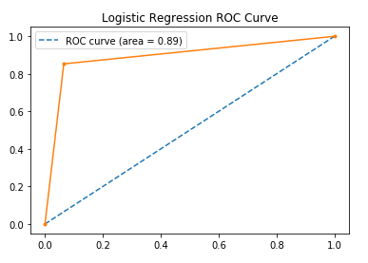
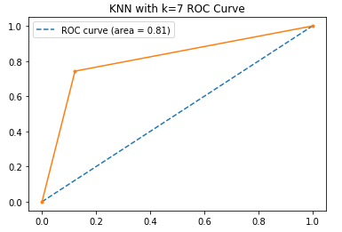
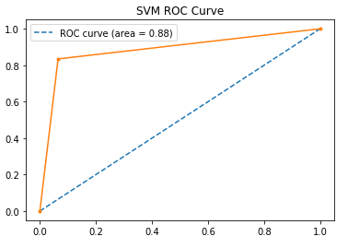
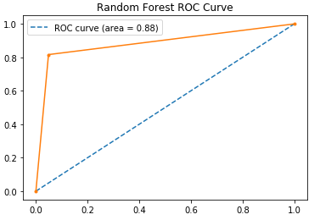
Model Evaluation
Cross-Validation used to find optimal parameters for each model.

Slide 17
Model Selection
Best Model Chosen as Logistic Regression as its ROC score is 89.4%
Random Forest yielded the a similar ROC score but to keep the model interpretable we select the simplest model.
Expected Error Rate for Logistic Regression is approx. 11%
False Positive Rate: 2.2%
False Negative Rate: 14.67%

Slide 18
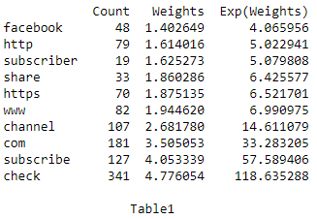
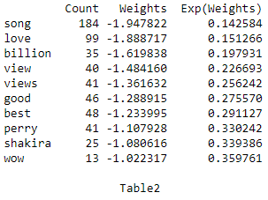
Most Significant Features
Interpreting the weights predicted by Logistic Regression:
Table1 shows the top 10 words that contribute most to the odds of beings an ad comment.
Table2 shows the top 10 words that contribute least to the odds of beings an ad comment i.e. Non-Ad comments

Slide 19
Section - B
Source Code

Slide 20
Code Snippets
Importing all the required libraries
import pandas as pd
import numpy as np
import re
import matplotlib.pyplot as plt
from wordcloud import WordCloud, STOPWORDS
from nltk import WordNetLemmatizer
from sklearn.feature_extraction.text import TfidfTransformer
from sklearn.linear_model import LogisticRegression
from sklearn.ensemble import RandomForestClassifier
from sklearn.linear_model import SGDClassifier
from sklearn.neighbors import KNeighborsClassifier
from sklearn.feature_extraction.text import CountVectorizer
from sklearn.model_selection import train_test_split,GridSearchCV
from sklearn.metrics import confusion_matrix,classification_report,accuracy_score,roc_auc_score,roc_curve

Slide 21
Code Snippets
The function takes the content as input and outputs all the comments stripping everything ( numbers, punctuations ), performing lemmatization and converting to lower case.
def stripped_text(text):
l=WordNetLemmatizer()
tokens=[l.lemmatize(i) for i in text.split()]
text=" ".join(tokens)
return " ".join(re.findall("[A-Za-z]+",text.lower()))

Slide 22
Code Snippets
Load the data and preprocess the data
def load_data():
df_train = pd.read_csv('Data Sets/train.csv')
df_test = pd.read_csv('Data Sets/test.csv')
print('Train',df_train.head())
print('Test',df_test.head())
print(df_train.info())
df_train.reset_index(inplace=True)
df_test.reset_index(inplace=True)
# Feature Selection: Careful examination of the data reveals that the classification is purely based on the COMMENT
# and the CLASS. So we remove the other features.
df_train=df_train[['CONTENT','CLASS']]
df_test=df_test[['index','CONTENT']]
# Veiwing for the value counts to check for class imbalance.
df_train['CLASS'].value_counts()
# No class imbalance present, so we can move forward with pre-processing the text data
return df_train,df_test

Slide 23
Code Snippets
Text Preprocessing and feature extraction
def preprocess_text(df):
df.loc[:,'CONTENT']=df['CONTENT'].apply(stripped_text)
# Count words and their occurences in the data
c_vec = CountVectorizer(stop_words='english')
X_c = c_vec.fit_transform(df['CONTENT'])
t = TfidfTransformer()
X_tfidf = t.fit_transform(X_c)
return df,c_vec,t,X_tfidf

Slide 24
Code Snippets
Trains the desired model selected using type.
def train(X,y,type='LR'):
if type=='LR':
model = LogisticRegression(random_state=123)
elif type=='RF':
model = RandomForestClassifier(random_state=123)
elif type=='SVM':
model = SGDClassifier(random_state=123)
elif type == 'KNN':
model=KNeighborsClassifier()
# Dividing the data into train and test
X_train, X_test, y_train, y_test = train_test_split(X,y,test_size=0.2,random_state=112)
model.fit(X_train,y_train)
return model,X_train, X_test, y_train, y_test

Slide 25
Code Snippets
Finding optimal params using cross validation
def cross_validate(X,y,type='LR'):
if type=='LR':
parameters = {'penalty' : ['l1','l2'],'max_iter': [100,300,500],'random_state': [123]}
model = GridSearchCV(LogisticRegression(),parameters)
elif type=='RF':
parameters = { 'max_depth' : [1,3,5], 'n_estimators': [50,100], 'max_features': ['sqrt', 'auto', 'log2'], 'min_samples_leaf': [1, 5, 10], 'bootstrap': [True, False], 'random_state':[123]}
model = GridSearchCV(RandomForestClassifier(),parameters)
elif type=='SVM':
parameters ={ 'loss' : ['hinge'], 'penalty': ['l1','l2','elasticnet'], 'learning_rate': ['optimal', 'invscaling'], 'eta0':[0.01,0.1,0.001,0.0001], 'random_state': [123] }
model = GridSearchCV(SGDClassifier(),parameters)
elif type=='KNN':
parameters ={ 'n_neighbors' : [3,5,7,9,11], 'p': [1,2], }
model = GridSearchCV(KNeighborsClassifier(),parameters)
# Dividing the data into train and test
X_train, X_test, y_train, y_test = train_test_split(X,y,test_size=0.2,random_state=112)
model.fit(X_train,y_train)
return model,X_train, X_test, y_train, y_test

Slide 26
Code Snippets
Model Evaluation using sklearn metrics
def evaluate_model(model,X_train, X_test, y_train, y_test):
predictions = model.predict(X_train)
print('Train Evaluation')
print(confusion_matrix(y_train,predictions))
print(roc_auc_score(y_train,predictions))
print(classification_report(y_train,predictions))
predictions = model.predict(X_test)
print('Test Evaluation')
print(confusion_matrix(y_test,predictions))
print(roc_auc_score(y_test,predictions))
print(classification_report(y_test,predictions))
auc=roc_auc_score(y_test,predictions)
# calculate roc curve
fpr, tpr, thresholds = roc_curve(y_test,predictions)
plt.plot([0, 1], [0, 1], linestyle='--',label='ROC curve (area = %0.2f)' % auc)
# plot the roc curve for the model
plt.plot(fpr, tpr, marker='.')
plt.legend()
plt.xlabel('FPR')
plt.ylabel('TPR')
plt.show()

Slide 27
Code Snippets
Generating submission from test data
def predict_class(df,c_vec,t,model,filename):
comment=df['CONTENT'].apply(stripped_text)
comment_c=c_vec.transform(comment)
comment_tfidf=t.transform(comment_c)
preds = model.predict(comment_tfidf)
df['CLASS']=preds
df.columns=['ID','CONTENT','CLASS']
df.to_csv(filename,columns=['ID','CLASS'],header=True,index=False)

Slide 28
Code Snippets
Generate Word Cloud from text for Ads by default
def generate_wordcloud(df,c=1):
comment_words = ''
stopwords = set(STOPWORDS)
for val in df[df.CLASS==c].CONTENT:
val = str(val).lower()
tokens = val.split()
for word in tokens:
comment_words = comment_words + word + ' '
wordcloud = WordCloud(width = 800, height = 800, background_color ='white', stopwords = stopwords,
min_font_size = 10).generate(comment_words)
plt.figure(figsize = (8, 8), facecolor = None)
plt.imshow(wordcloud)
plt.axis("off")
plt.tight_layout(pad = 0)
t='Non-Ads'
if c==1:
t='Ads'
plt.title(f'Word Cloud for {t}')
plt.show()

Slide 29
Code Snippets
Extracts the most significant features from the model's coeffiecients
def most_significant_features(model,df,c_vec):
df.loc[:,'CONTENT']=df['CONTENT'].apply(stripped_text)
X_c=c_vec.transform(df['CONTENT'])
wc=pd.DataFrame(X_c.toarray().sum(axis=0).reshape(-1,1),columns=['Count'],index=c_vec.get_feature_names())
wc['Weights']=model.coef_[0]
wc['Exp(Weights)']=wc.Weights.apply(np.exp)
wc=wc.sort_values(by='Exp(Weights)')
print(wc.head(10))
print(f'\n Table1')
print(wc.tail(10))
print(f'\n Table2')

Slide 30
Code Snippets
Executing the script
if __name__=='__main__':
tr,te=load_data()
generate_wordcloud(tr)
tr,c_vec,t,X=preprocess_text(tr)
print('Logistic Regression')
model_lr,X_train, X_test, y_train, y_test=train(X,tr['CLASS'])
evaluate_model(model_lr,X_train, X_test, y_train, y_test)
predict_class(te,c_vec,t,model_lr,'./preds_lr.csv')
print('Cross-Validation Results')
model_lr_cv, X_train, X_test, y_train, y_test=cross_validate(X,tr['CLASS'])
evaluate_model(model_lr_cv, X_train, X_test, y_train, y_test)
predict_class(te,c_vec,t,model_lr_cv,'./preds_lr_cv.csv')
print('Random Forest Classification')
model_rf,X_train, X_test, y_train, y_test=train(X,tr['CLASS'],'RF')
evaluate_model(model_rf,X_train, X_test, y_train, y_test)
predict_class(te,c_vec,t,model_rf,'./preds_rf.csv')
print('Cross-Validation Results')
model_rf_cv,X_train, X_test, y_train, y_test=cross_validate(X,tr['CLASS'],'RF')
evaluate_model(model_rf_cv,X_train, X_test, y_train, y_test)
predict_class(te,c_vec,t,model_rf_cv,'./preds_rf_cv.csv')

Slide 31
Code Snippets
Executing the script
print('SVM Classifier')
model_svm,X_train, X_test, y_train, y_test=train(X,tr['CLASS'],'SVM')
evaluate_model(model_svm,X_train, X_test, y_train, y_test)
predict_class(te,c_vec,t,model_svm,'./preds_svm.csv')
print('Cross-Validation Results')
model_svm_cv,X_train, X_test, y_train, y_test=cross_validate(X,tr['CLASS'],'SVM')
evaluate_model(model_svm_cv,X_train, X_test, y_train, y_test)
predict_class(te,c_vec,t,model_svm_cv,'./preds_svm_cv.csv')
print('KNN Classifier')
model_knn,X_train, X_test, y_train, y_test=train(X,tr['CLASS'],'KNN')
evaluate_model(model_knn,X_train, X_test, y_train, y_test)
predict_class(te,c_vec,t,model_knn,'./preds_knn.csv')
print('Cross-Validation Results')
model_knn_cv,X_train, X_test, y_train, y_test=cross_validate(X,tr['CLASS'],'KNN')
evaluate_model(model_knn_cv,X_train, X_test, y_train, y_test)
predict_class(te,c_vec,t,model_knn_cv,'./preds_knn_cv.csv')
most_significant_features(model_lr,tr,c_vec)
most_significant_features(model_svm,tr,c_vec)

Slide 32
Thank You

